Slide 1
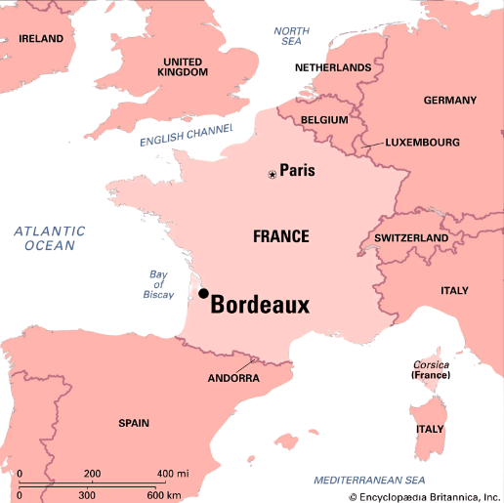

AIRBNB
Data Analysis Project
An Investment Perspective
Bordeaux
By Ivan Laptiev

Slide 2
Table of contents
01
02
03
About me & Bordeaux
The research questions
Analysis
assumptions
04
05
Data
analysis
Conclusion

Slide 3

About me
01
Mechina program for abroad students in 2016
Made aliya in 2017 from Ukraine
B.Sc. in Environmental Economics and Management – Hebrew University of Jerusalem
Drafted into the army – Financial Corps in 98th Division
Notes:
Names

Slide 4
Bordeaux
Context
world capital of wine
Unesco heritage
regional economic center
TOURISM
Located in the southwest of France, is one of the most famous wine-producing regions in the world.
Founded by the Romans over 2,000 years ago.
Vital commercial port
Annual wine production worth 2.5B €
900 Million bottles produced annually
15% of all wine produced in France
Designated a UNESCO World Heritage Site in 2007
Aerospace industry
Commercial hub
5th most attractive destinations in France
7 million tourists per Year
Over 3 Billion € of revenue per Year

Slide 5
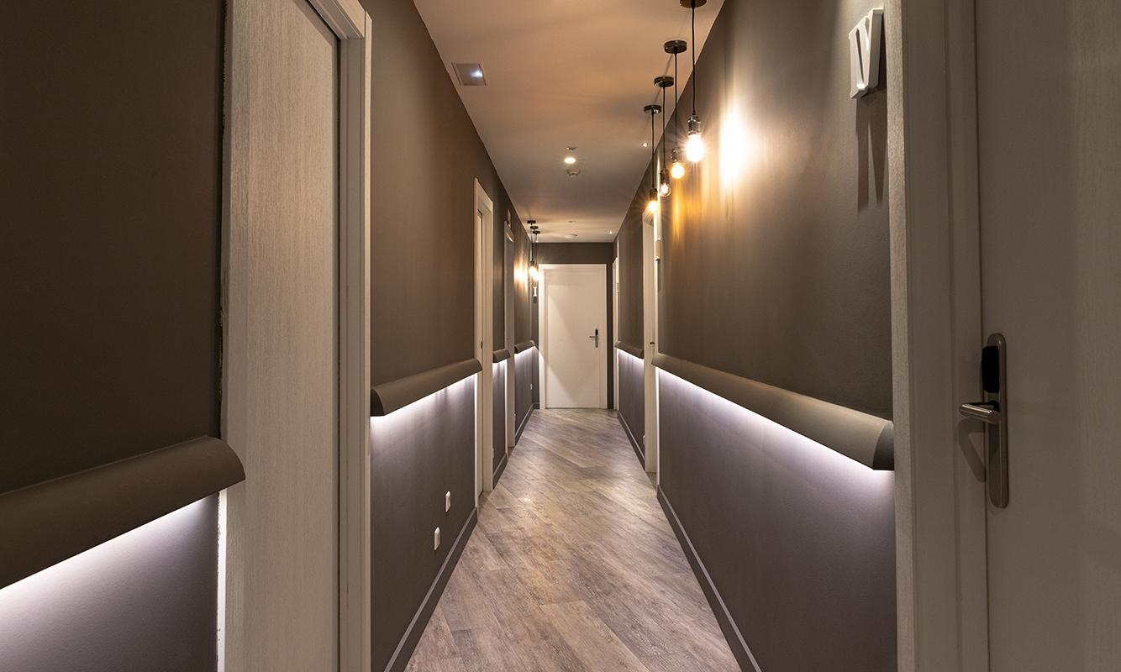
“AirBnB happened because Brian Chesky (airbnb c.E.O) couldn’t pay his rent, but did have some space.”
sam altman

Slide 6
The Research Question
02
What characteristics will yield high revenue for AIRBNB properties in Bordeaux?
In this project, I conducted a thorough analysis of the Bordeaux Airbnb open dataset.
I dived into a group of different variables to find the highest correlations affecting the revenue.
Notes:
להוסיף - קריטריונים עם הרבה רווח

Slide 7
What is Revenue?
Given the dataset, I decided to use the next calculation:
Annual Revenue
=
Daily Price
*
Yearly Occupancy
No expenses are taken into consideration while conducting the analysis!
Let’s take a closer look at these two variables…
Notes:
רווח שנתי - מחיר מטבלה ? - Occupancy ?

Slide 8
analysis assumptions
Assumption #1
Assumption #2
Assumption #3
Assumption #4
03
Used only data with Price and Occupancy
Excluded categories with low correlation under 2%
Filtered Property Type to a minimum of 29 units, which is 1% of properties
Focus on positive correlation between categorical variables

Slide 9
Data analysis
04

Slide 10
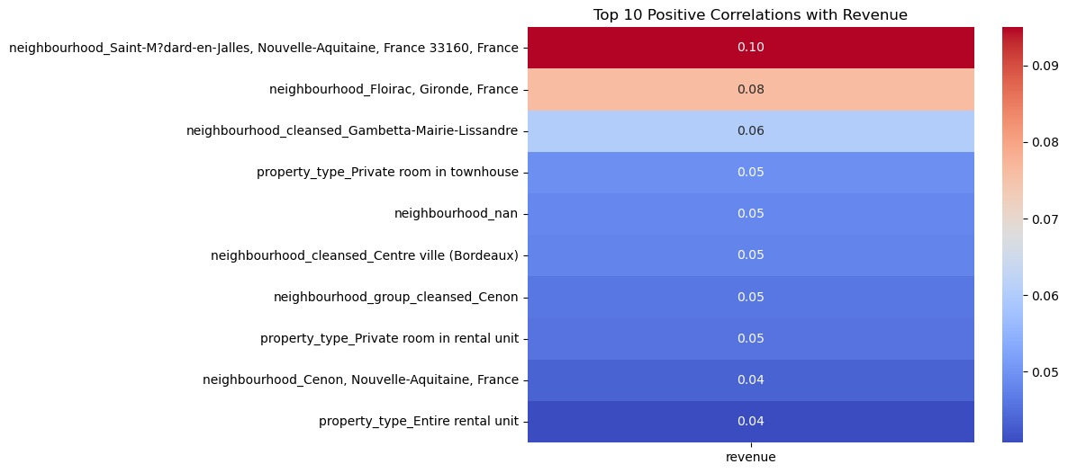
heatmap Correlation
Heatmap displays the Top 10 correlation of revenue with all other properties, sorted by the strength.
Neighbourhood
Holds the Highest Variable Correlation Coefficient
Property type
Holds 0.05 Correlation Coefficient
Notes:
להוריד PRICE, AVAILABILITY, min nights
REVIEWS?
למקד כמות FEATURES הרלוונטיים
What is success? Revenue
Neighbourhood, property type,

Slide 11
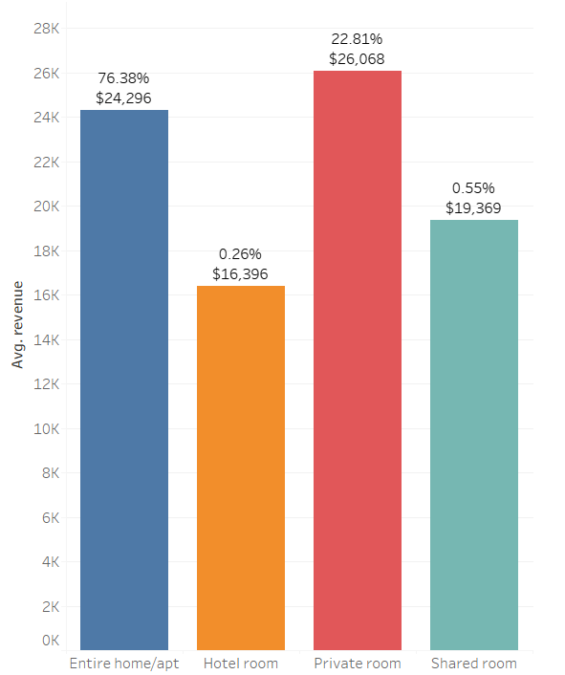
Room types Avg revenue
gender
Market share of room types with AVG revenue
Entire home - 76% $ 24K
Male - 70%
Female - 5%
Hotel room - 0.26% $ 16K
age
Private room - 23% $ 26K
21-30: 30%
31-40: 40%
Shared room - 0.5% $ 19K
+41: 30%

Slide 12
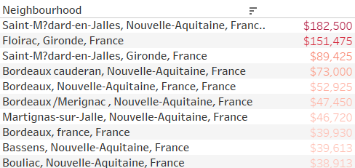
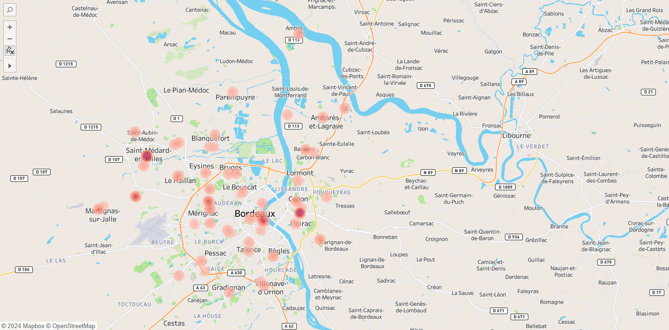
annual Revenue in neighbourhoods
Top 10
n.c.g Avg revenue
multimedia
Mercury is the closest planet to the Sun
press
Venus has extremely
high temperatures
Mobile app
Earth is the third planet from the Sun

Slide 13
About the neighbourhoods
Saint-médard-
en-jalles,
Nouvelle-Aquitaine
floirac, gironde
Saint-médard-
en-jalles,
Gironde
Occupancy: 365/365
Price: 500$
Property Type:
Entire Rental Unit
Review Scores: 4.74
Occupancy: 365/365
Price: 415$
Property Type:
Entire Home
Review Scores: 4.63
Occupancy: 365/365
Price: 245$
Property Type:
Entire Home
Review Scores: 4.73

Slide 14
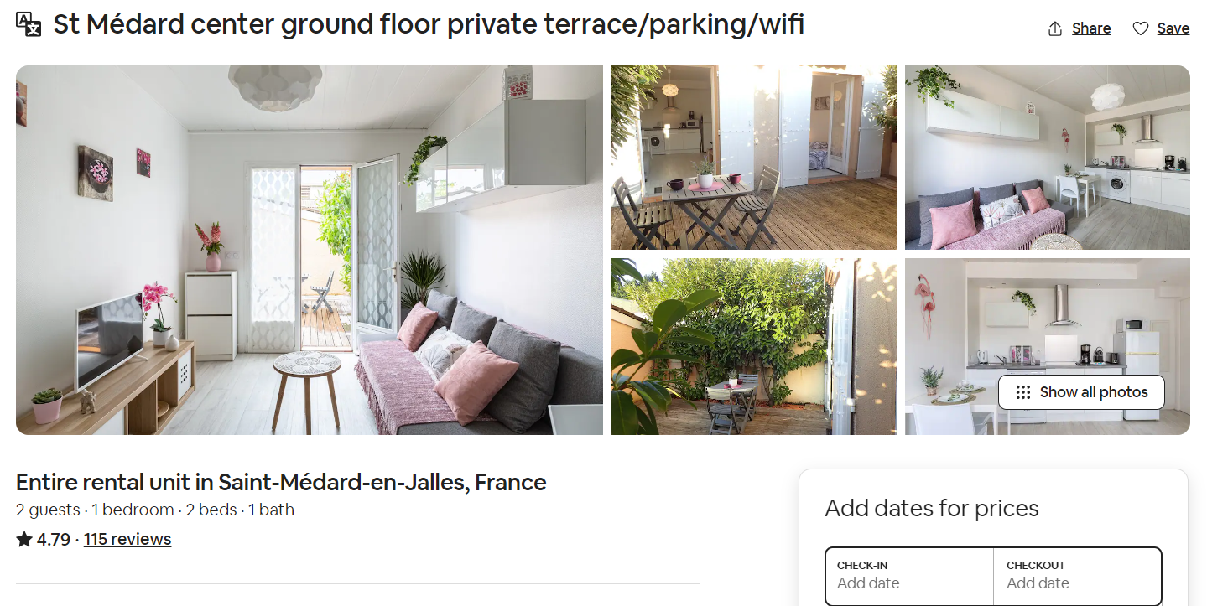
About the neighbourhoods
Saint-médard-
en-jalles,
Nouvelle-Aquitaine
Occupancy: 365/365
Price: 500$
Property Type:
Entire Rental Unit
Review Scores: 4.79

Slide 15
About the neighbourhoods
floirac, gironde
Occupancy: 365/365
Price: 415$
Property Type:
Entire Home
Review Scores: 4.63

Slide 16
About the neighbourhoods
Saint-médard-
en-jalles,
Gironde
Occupancy: 365/365
Price: 245$
Property Type:
Entire Home
Review Scores: 4.91

Slide 17
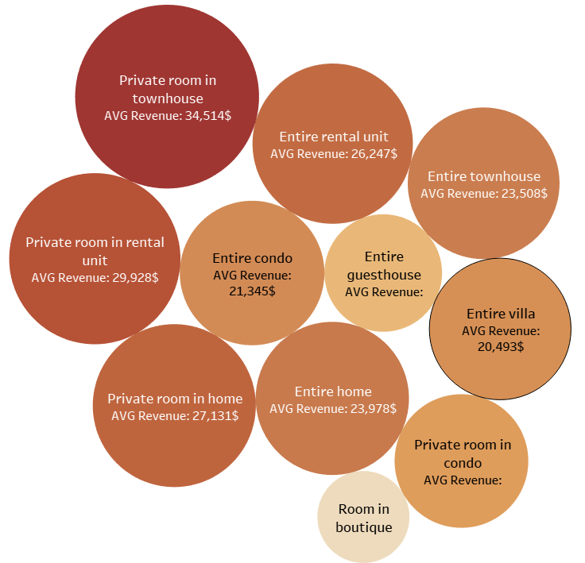
property types Avg revenue
Number of properties:
ABout today - 30%
Next week - 51%
Entire room in home
183
Mercury is the closest planet to the Sun
Venus has extremely high temperatures
Entire condo
393
Entire home
474
Next year - 75%
Next decade - 93%
Entire rental unit
993
Earth is the third planet from the Sun
Mars is actually a cold place

Slide 18
Conclusion
05

Slide 19
The Research results
Highest revenue neighborhood
Highest revenue room type
Highest revenue property type
Saint-Médard-en-Jalles
Private room
Private room in townhouse

Slide 20
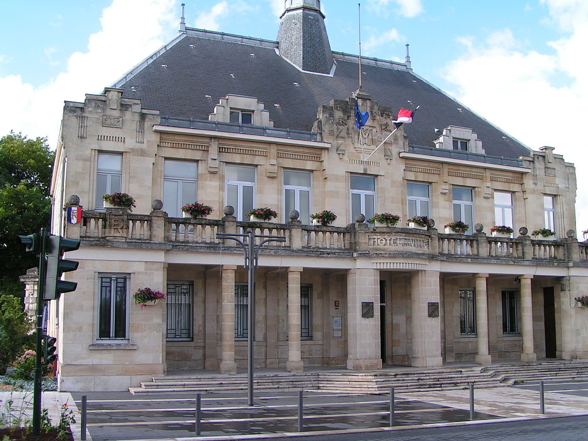
Highest revenue neighbourhood:
Saint-Médard-en-Jalles
Neighbourhood data
Price Range: $18-$500 per night
Average Annual Revenue: $27,590
Average Occupancy: 75.78%
Average Price:
$101

Slide 21
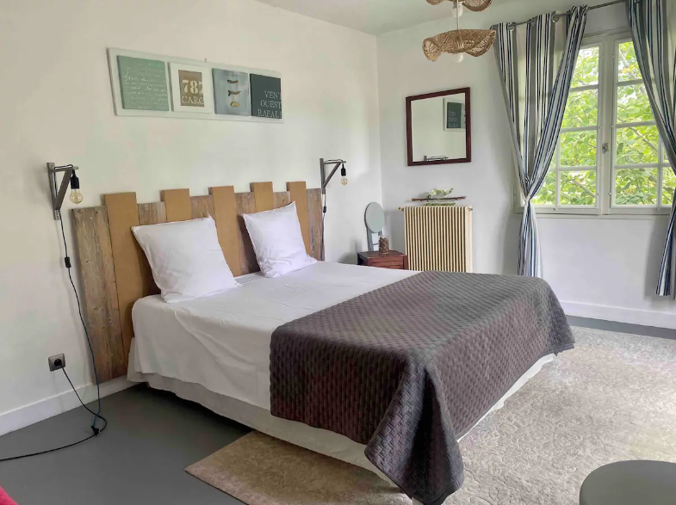
Highest revenue room type:
Private room
Room type data
Price Range: $15-$1600 per night
Average Annual Revenue: $26,068
Average Occupancy: 74%
Average Price: $108.5

Slide 22
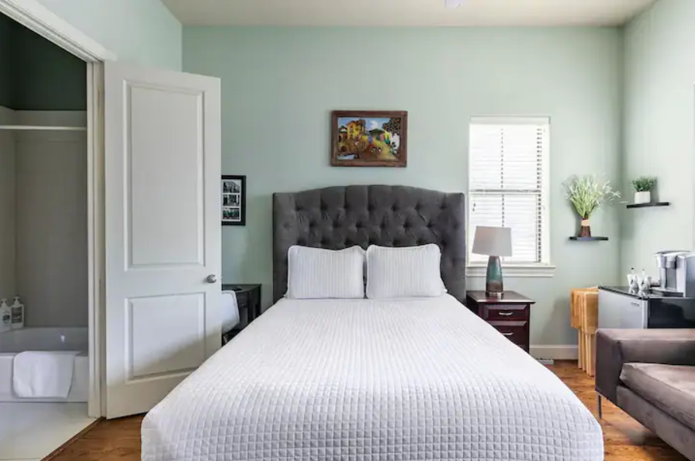
Highest revenue property type:
Private room in townhouse
property type data
Price Range: $21-$1400 per night
Average Annual Revenue: $34,514
Average Occupancy: 78.77%
Average Price: $122.27

Slide 23
Any questions ?
06

Slide 24
Thank
you!

